Slide 1
HR Analytics Solution Proposal
Atos
Presented By: Data Titans (Geeta Turkar & Nitin Sharma)

Slide 2
Overview
Analyzed HR data for 250 employees across Jan 2023 – April 2026
Transformed raw, unstructured data into a clean and reliable dataset
Designed an interactive Power BI dashboards to monitor key HR metrics
Generated actionable insights scalable data model to enable efficient analysis
Developed to drive data-informed decision-making

Slide 3
HR Analytics Overview
🔴 Problem
No centralized view of workforce metrics
Leadership unable to track total employees, salary, attrition, hiring trends
Decisions were based on fragmented data
✅ Solution
Built a central HR KPI dashboard showing:
Total Employees (250)
Attrition Rate (40%)
Avg Salary (697.8K annually)
Hiring trends over time
Department-wise employee distribution and gender split
💡 Key Insights / Impact
High attrition (40%) flagged as critical issue
IT department has highest workforce share
Hiring trends show growth but not retention balance

Slide 4
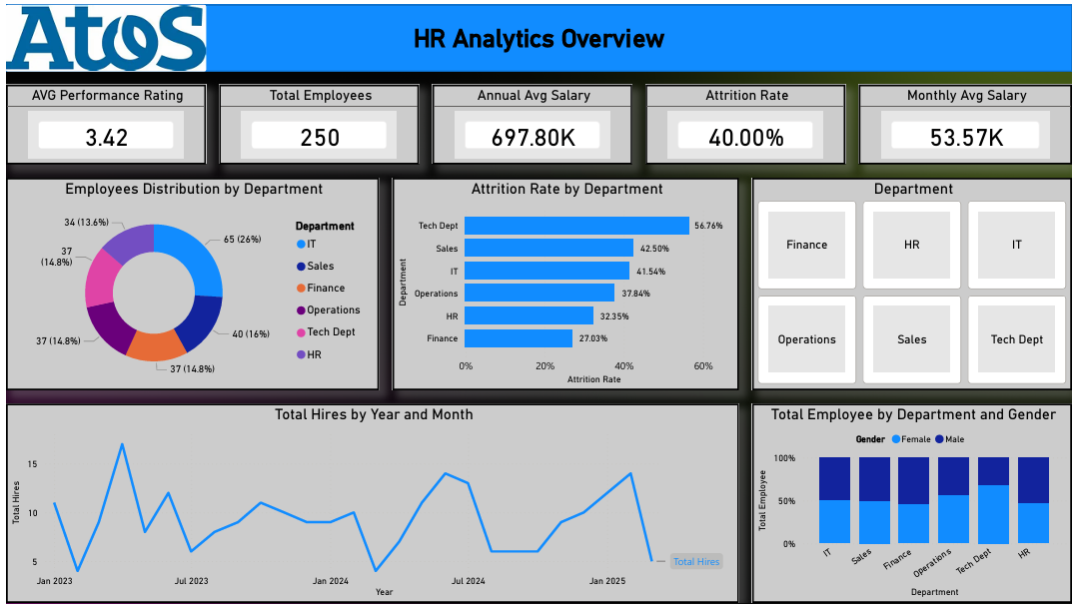

Slide 5
Employee Attrition Analysis
🔴 Problem
High attrition but no clarity on reasons or affected departments
HR unable to identify who is leaving and why
✅ Solution
Built attrition dashboard with:
Attrition by department
Gender-wise attrition split
Root cause analysis (Salary, Work-life balance, Opportunity)
Salary vs attrition correlation
💡 Key Insights / Impact
IT has highest attrition (27 employees)
Female attrition slightly higher (52%)
Top reasons:
Salary (70.3%)
Work-life balance

Slide 6
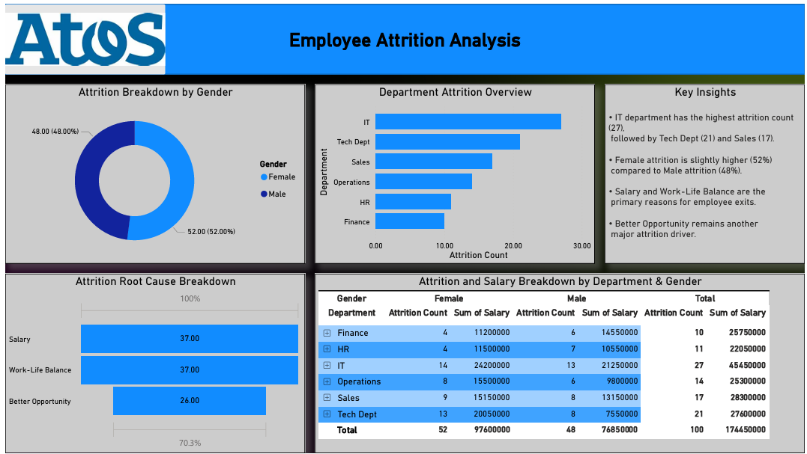

Slide 7
Employee Attendance & Absenteeism
🔴 Problem
No tracking of employee attendance & productivity
High absenteeism affecting operations
✅ Solution
Built attendance dashboard with:
Attendance rate (58.48%)
Department-wise present & absent days
Trend analysis over time
Gender-based attendance comparison
💡 Key Insights / Impact
Attendance is low (~58%)
IT & Operations show higher absenteeism 👉 Helps improve workforce utilization & policy enforcement

Slide 8
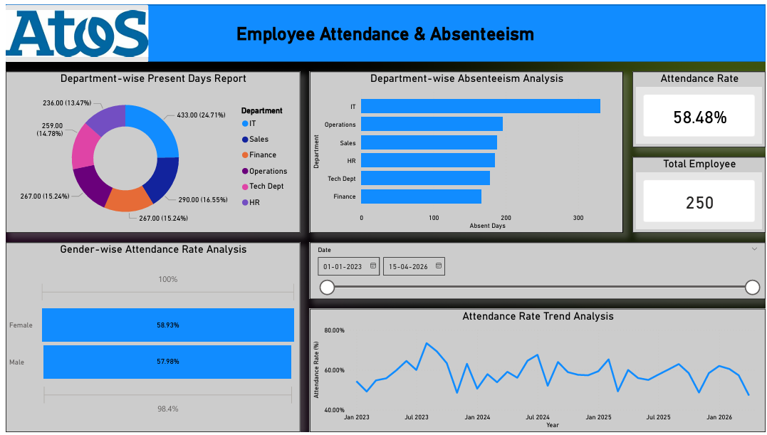

Slide 9
Employee Demographics Analysis
🔴 Problem
No visibility into employee distribution, diversity, and structure
Difficult workforce planning
✅ Solution
Dashboard showing:
Gender distribution (52.8% Female, 47.2% Male)
Department-wise employee count
Employment status (Active vs Exited)
Year-wise hiring distribution
💡 Key Insights / Impact
Workforce fairly balanced gender-wise
65 employees exited → retention issue confirmed 👉 Supports diversity tracking & workforce planning

Slide 10
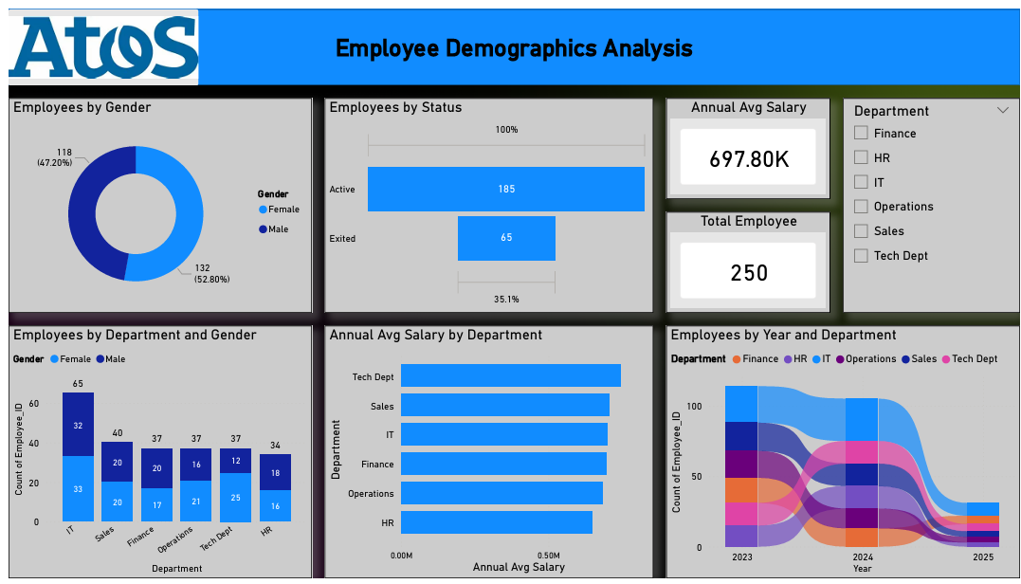

Slide 11
Employee Performance Analytics
🔴 Problem
No structured way to track performance ratings
Managers lacked visibility into top vs low performers
✅ Solution
Dashboard includes:
Average rating by department
Performance distribution (Top, Average, Low)
Salary vs performance comparison
💡 Key Insights / Impact
Avg rating = 3.42 (moderate performance)
Top performers = ~50%
Low performers need training 👉 Enables performance-driven HR strategies

Slide 12
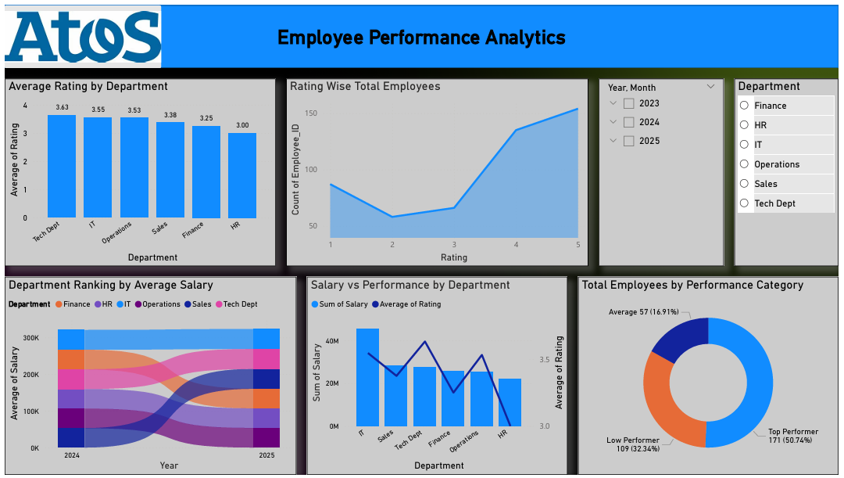

Slide 13
Payroll Analytics
🔴 Problem
No clarity on salary distribution, payroll cost, and bonuses
Difficult to manage compensation planning
✅ Solution
Dashboard includes:
Total payroll cost (41M)
Avg salary (53.57K)
Department-wise salary breakdown
Bonus distribution
💡 Key Insights / Impact
IT has highest payroll cost
Salary distribution relatively stable across departments 👉 Supports budgeting & compensation optimization

Slide 14
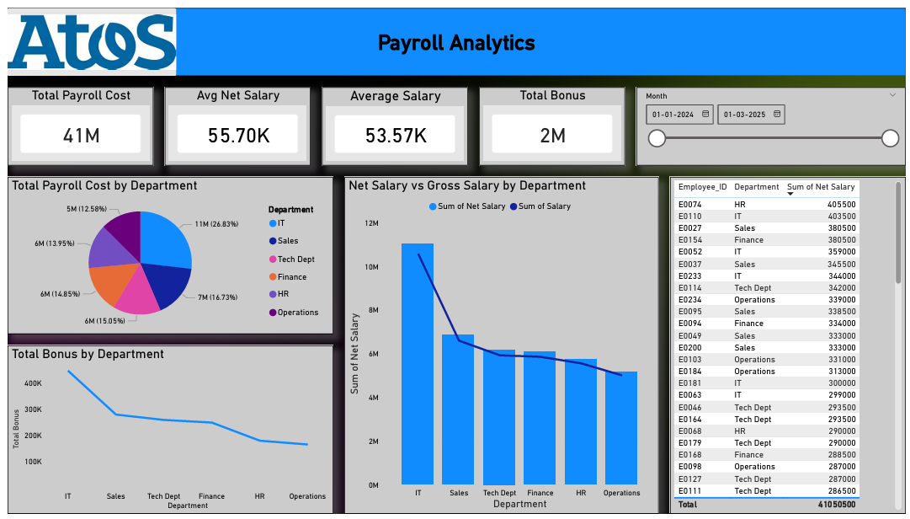

Slide 15
Recruitment Performance Overview
🔴 Problem
Inefficient hiring process
No tracking of conversion funnel (Applied → Interviewed → Joined)
✅ Solution
Built recruitment funnel dashboard:
Candidates applied, interviewed, offers made, joined
Department-wise hiring efficiency
💡 Key Insights / Impact
51 applied → 41 interviewed → 54 joined
Hiring process inconsistent across departments 👉 Improves recruitment efficiency & planning

Slide 16
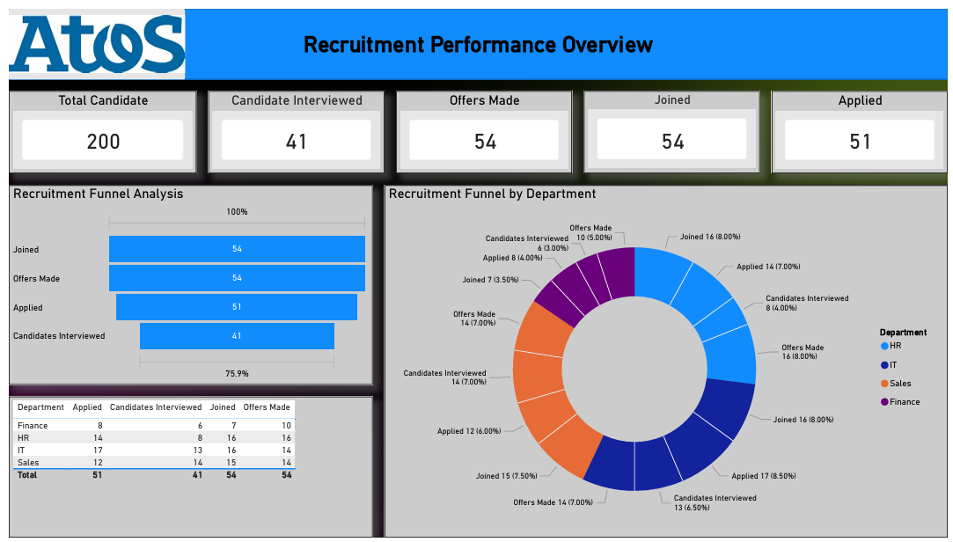

Slide 17
Employee Training & Completion
🔴 Problem
No tracking of employee training participation & completion
Skill gaps not identified
✅ Solution
Dashboard includes:
Total trainings (291)
Completion rate (64.95%)
Training types (Python, Excel, Leadership)
Department-wise completion
💡 Key Insights / Impact
Training completion is moderate (~65%)
Python & Excel most popular 👉 Helps improve learning & development strategy

Slide 18
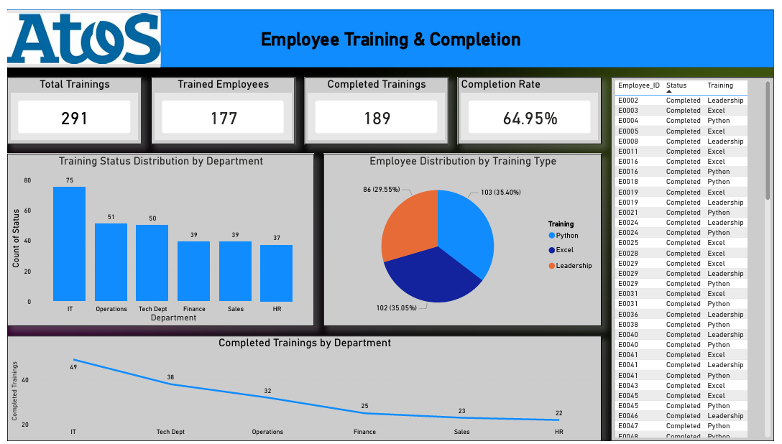

Slide 19
Salary vs Performance
🔴 Problem
No clarity on whether salary aligns with performance
✅ Solution
Combined dashboard showing:
Salary vs rating correlation
Performance category breakdown
💡 Key Insights / Impact
Avg salary: 53.57K
Top performers have highest rating (4.53)
Salary differences are minimal across performance levels 👉 Indicates need for performance-based pay structure

Slide 20
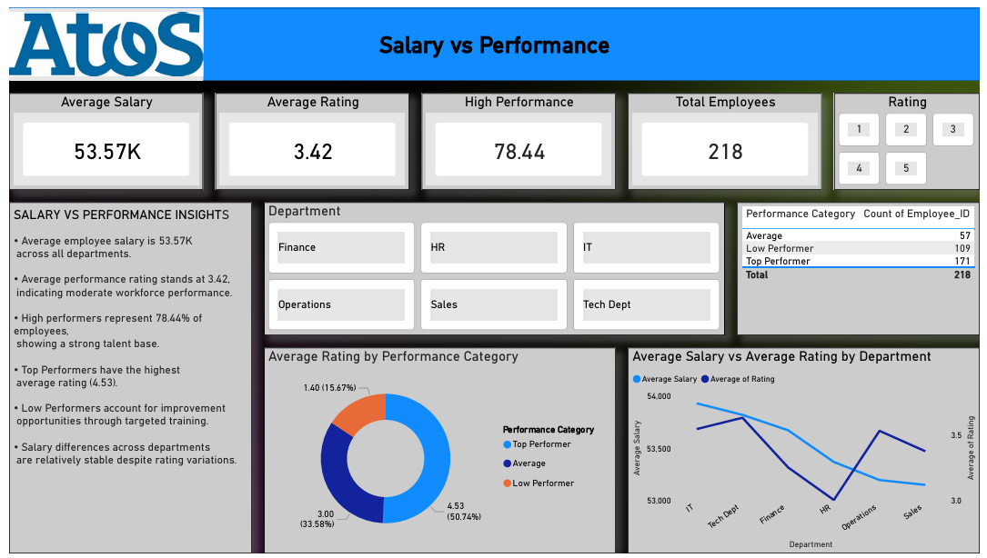

Slide 21
🚀 Overall Impact
Reduced attrition through root cause insights
Improved hiring efficiency
Enabled data-driven HR decisions
Better workforce planning & performance tracking

Slide 22
Thank You!

